Slide 1
Tapestry Online Learning Journal

Slide 2
What is Tapestry?
Tapestry is an online learning journal system
There is an app and browser version available
We can use it to record children’s learning and development using tablet devices and PCs
We will set you up as parents, with your own secure logins so you can view, comment on and add your own observations to your child’s journal.
When your child leaves, we will export a PDF copy of your child’s journal and a ZIP file including photos and videos for you
If they move to another setting also using Tapestry, their journal can be transferred across as well as your account

Slide 3
Why are we using Tapestry?
It creates a two way communication between us (the staff), and you (the parents and carers)
We can upload media, meaning you can see pictures and videos of what your child is really up to whilst they are with us
There are greater opportunities to extend your child’s learning at home – you can view next steps, add your own observations and communicate with us whenever you like
Unlike a physical, hard copy book, it’s easy to share with groups of relatives, such as extended families, separated parents and relatives living overseas

Slide 4
How is the data kept safe?
A password is required to access Tapestry, remember the stronger the password you set, the more secure your account is
You are linked manually to your child/children and the group activities profile, so you can only view observations for them
We don’t need to store any of the data entered onto Tapestry, they store it for us on secure cloud servers within the EU
Data is stored separately for each school
Tapestry’s developers and support personnel require our permission to access our Tapestry account
For more information about Tapestry security you can go on their website https://tapestry.info/security.html

Slide 5
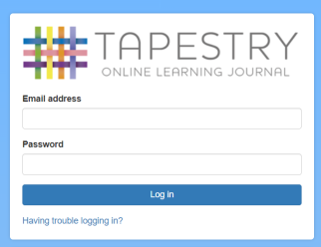
Logging in
To login to Tapestry we will need to have an email address for you
Once you activate your account you can then login using your email and password
You can reset your password by email if you forget it
Passwords are case sensitive
Remember to set a strong password
You can read this article for some guidance on how to set a strong and memorable password https://eyfs.info/forums/topic/47249-password-setting-advice/

Slide 6
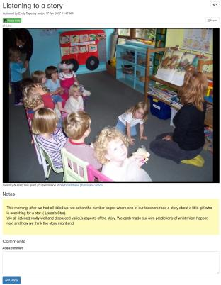
Observations
When you login to your account you will be able to see any observations for your child that have been added to their journal
You will be able to see any photos/videos/audio files/documents attached to the observation. For group observations, your child will only be visible if you have given your consent for other relatives to see photos/videos including your child
Underneath the media you will see the notes, so the actual observation
You will also be able to add comments and like the observation
You can also add your own observations, of things you’ve done out of pre-school

Slide 7
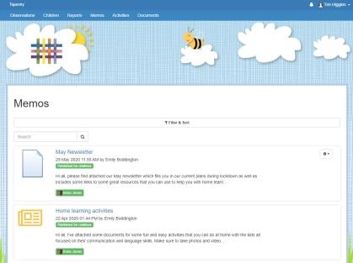
Memos
Memos allow us to share messages with you such as reminders and newsletters
They are separate to observations
You will also be able to add comments and like memos

Slide 8
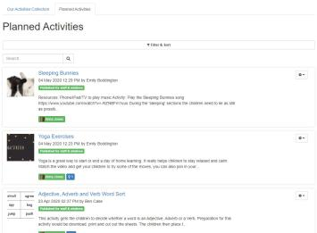
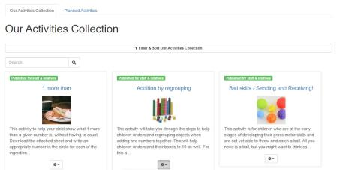
Activities
There are two sections in Activities: Planned Activities and Our Activities Collection
Our Activities Collection – this is our setting’s bank of activity ideas, you can look through here for inspiration
Planned Activities – these are activities we think it would be good for you to try at home, you can reply to planned activities with observations so they are linked
you will also be able to comment on planned activities and activities in our collection

Slide 9
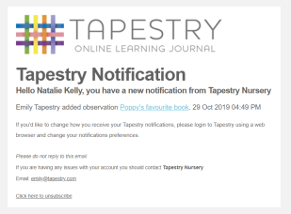
Notifications
If you would like to receive notifications it’s possible to receive email notifications immediately, daily or weekly
There are different notifications for things like new observations and observation comments
On the new version of the app you can also receive push notifications

Slide 10
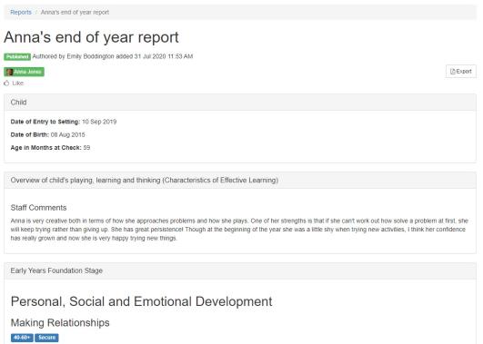
Reports
This allows us to create reports at different times of the year and share these with you
They may include documents which you can download
You will also be able to add your own comments to reports

Slide 11
Documents
This feature allows us to upload our documents and share them with you
It’s only available on the browser version of Tapestry
We can organise the documents into folders
We’ll use this for sharing information like: our policies, our term dates and newsletters

Slide 12
How will you get started?
When your child joins us, we will;
Ask for your permission to add your child to Tapestry, along with the options for photograph permissions.
Send you an email directly from Tapestry, inviting you to register. (this may go to your junk, so please check there too)
Set up your child’s profile on Tapestry, along with a welcome observation so you can see what the information you’ll receive will look like

